Slide 1
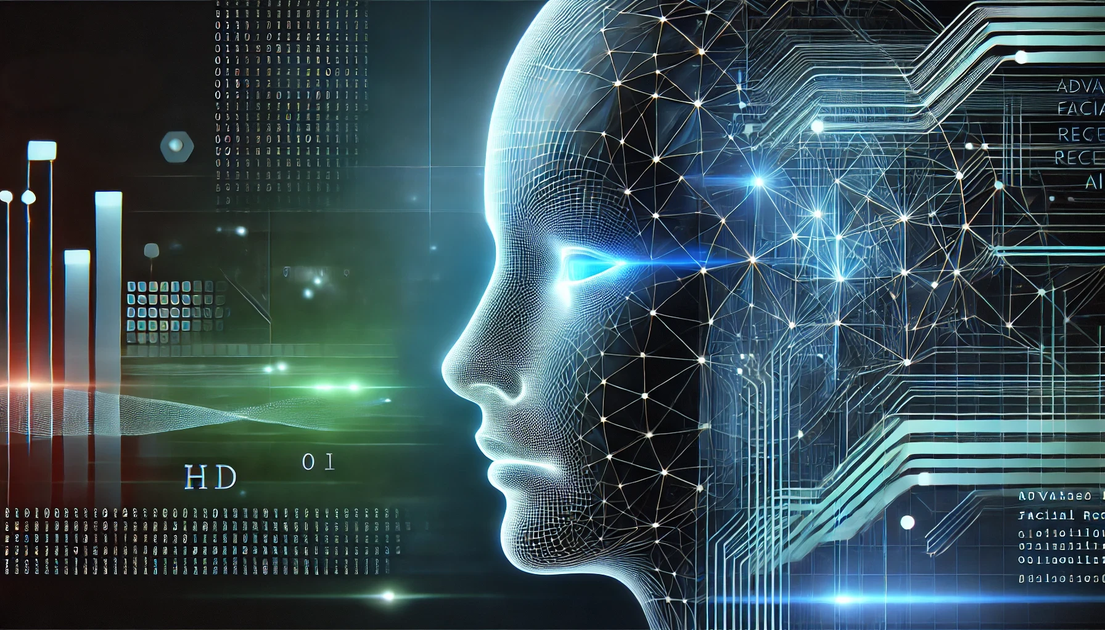
Advanced Facial Recognition and Bias Mitigation
Group4: Bala Srimani Durga Devi Chikkala (2290061), Saikiran Anugam (2312298), Vishnu Vardhan Mullapudi (2253445), Azharmadani Syed (2316906), Sunil Kumar Kommineni (2304770)

Slide 2

Introduction
Facial recognition systems often face criticism for biases from imbalanced datasets, leading to inaccuracies across demographic groups.
This project addresses these concerns by leveraging the FairFace dataset, a comprehensive collection of over 100,000 labeled images designed to ensure balanced representation.
FairFace spans seven racial groups, multiple age brackets, and binary genders, providing a diverse and inclusive foundation for training fairness-aware models.
Our project aims to build a facial recognition system that prioritizes equitable and accurate predictions across all demographic categories by utilizing this dataset.

Slide 3
Problem Statement
Facial recognition systems face biases due to imbalanced datasets, affecting accuracy for underrepresented groups.
These biases lead to unfair outcomes and ethical concerns in real-world applications.
The project aims to build a fairness-aware system to ensure accurate predictions across demographics.
The focus is on multi-task learning for age, race, and gender.

Slide 4
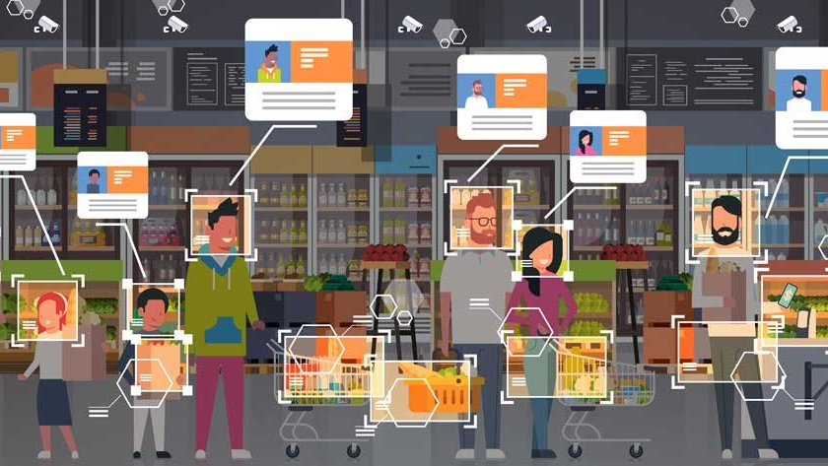
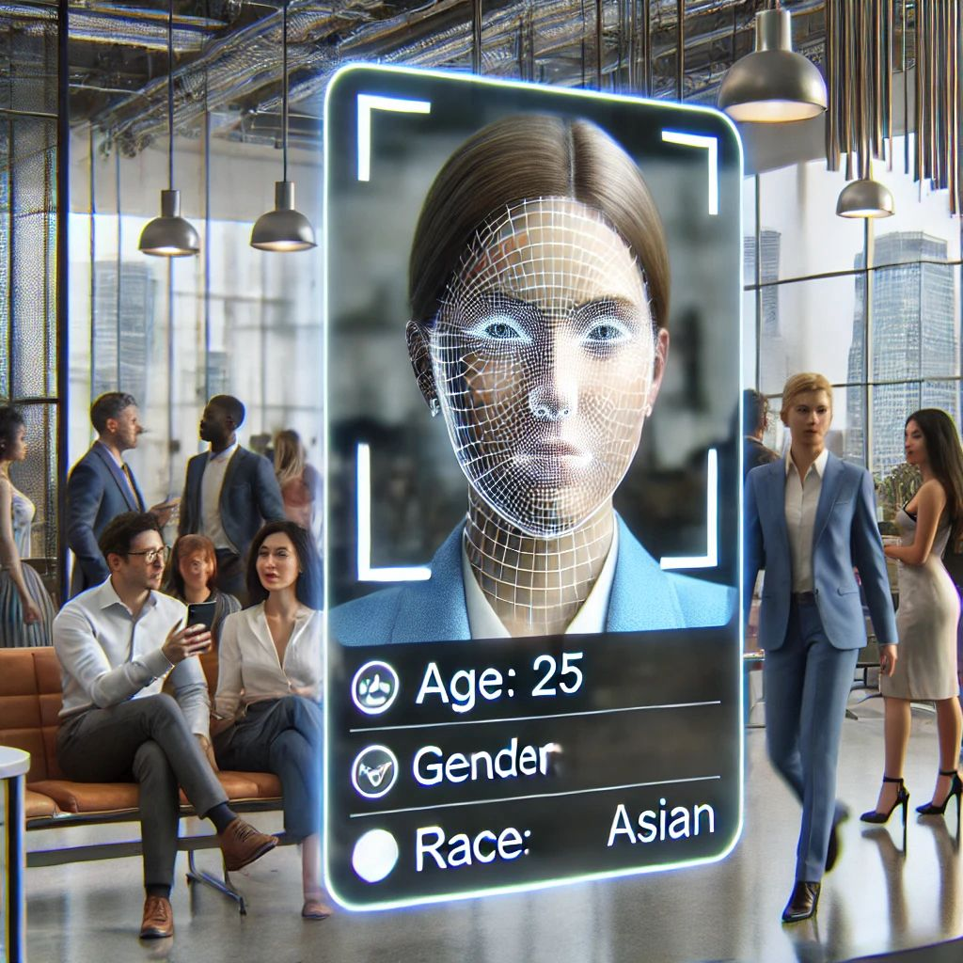
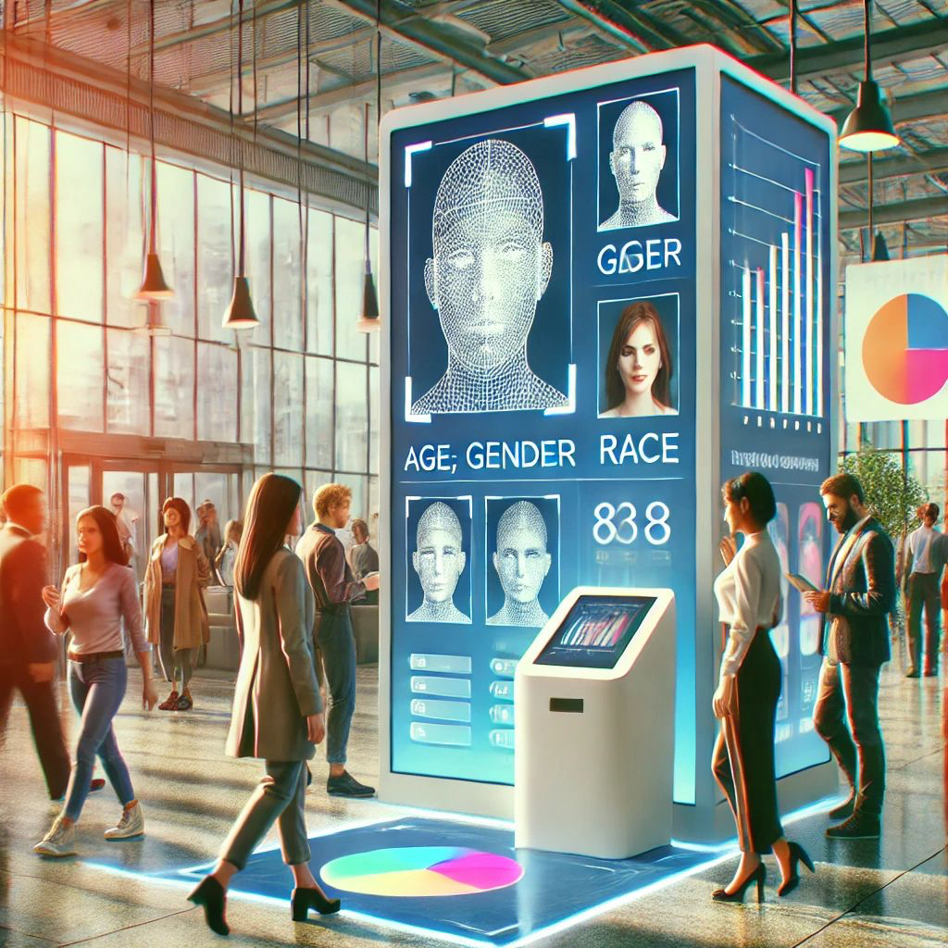
Applications

Slide 5
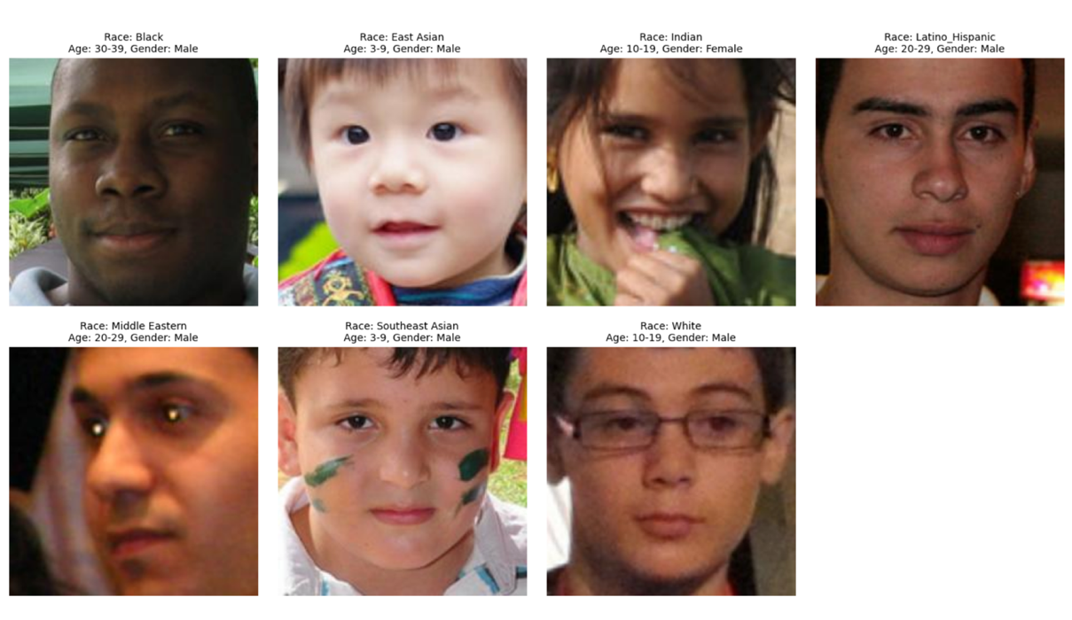
Sample of dataset

Slide 6
Workflow
Problem Statement: To find age, race and gender from an image input
Finding the perfect dataset
(Fairface dataset)
Image Preprocessing
RestNet50
EfficientNetB0
Model Building
MobileNetV2
Model Evaluation
InceptionV3
Fine Tuning
Vgg16
Final Image Prediction

Slide 7
Data Preprocessing
Resizing images to 224x224 pixels
Normalization
(scaling to [0, 1])
Data Augmentation (flipping, scaling, cropping)
Label Encoding using
one-hot encoding

Slide 8
Models Used
EfficientNetB0: High accuracy, low latency.
ResNet50: Robust hierarchical features.
MobileNetV2: Lightweight and efficient.
InceptionV3: Multi-scale feature extraction.

Slide 9
Model Evaluation & Fine tuning
Unfreezing additional layers.
Regularization (Dropout, L2).
Hyperparameter Optimization (Grid Search, Bayesian Optimization).
Early stopping and learning rate scheduling.

Slide 10
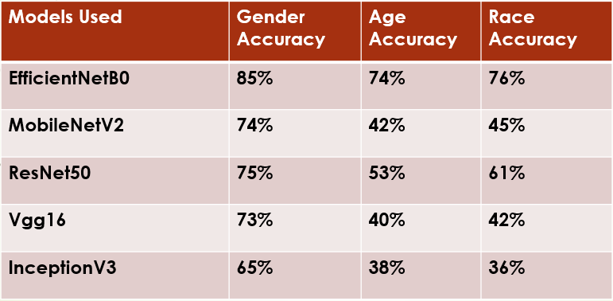
Results

Slide 11


Slide 12
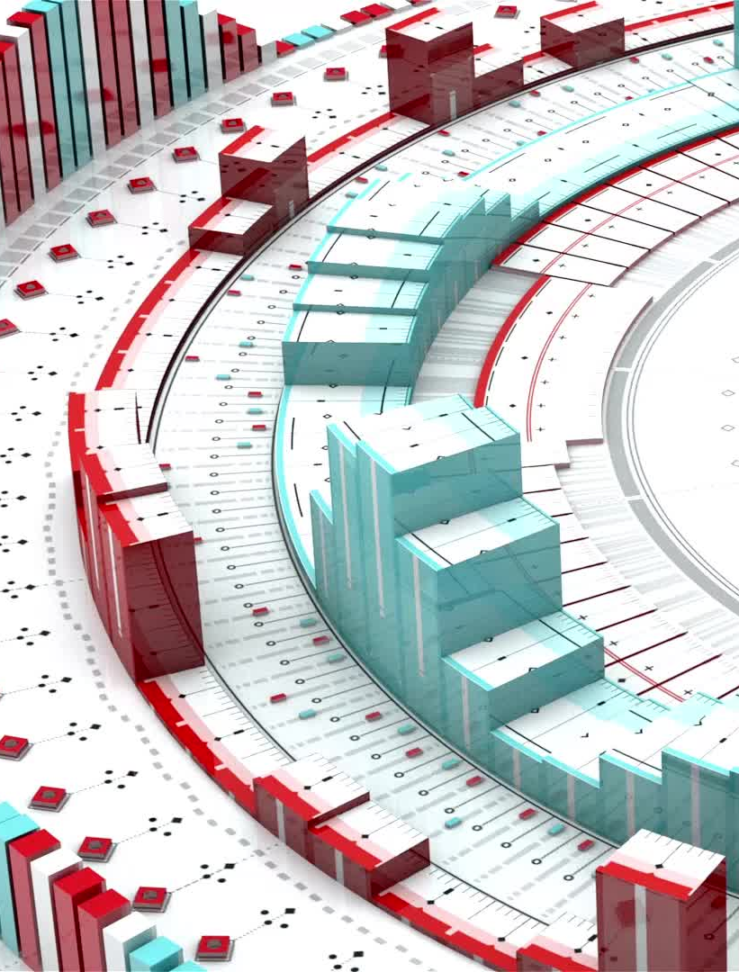
Challenges& Future scope
Challenges:
Bias: Limited accuracy for underrepresented groups due to imbalanced datasets.
Real-Time: High computational needs for live processing.
Future scope:
Integration: Connect with surveillance for live analysis.
Accuracy: Use diverse datasets for better detection.
Analytics: Add behavioral and predictive insights.

Slide 13


